Slide 1
PARASITOLOGY (BIOL 460)
UNIT 8 A
PARASITIC INSECTS-THE DIPTERA (FLIES)

Slide 2
PARASITIC INSECTS - THE DIPTERA (FLIES)
The Diptera are by far the most medically important among all orders of insects
Various flies are involved in the transmission of/or the cause of disfiguring, debilitating diseases either as vectors or as parasites themselves
The Order (Diptera) is so large, containing about 120,000 species in about 140 families (according to the source)

Slide 3
PARASITIC INSECTS - THE DIPTERA (FLIES) CONT’D
Because of their numbers, and diversity of form and feeding habits, both as larvae and as adults, the structure of mouthparts also is diverse
The lifecycle exhibits complete metamorphosis in which there is usually the egg, larval, pupal and adult stages

Slide 4
PARASITIC INSECTS - THE DIPTERA (FLIES) CONT’D
Those involved in disease transmission or are parasitic themselves are:
Mosquitoes: Anopheles. Culex, Aedes, Mansonia species
Sandflies: Phlebotomus, Lutzomyia species
Blackflies: Simulium species
Horseflies: Chrysops species
Midges: Culicoides species

Slide 5
PARASITIC INSECTS - THE DIPTERA (FLIES) CONT’D
Tsetseflies: Glossina species
Houseflies: Musca species, and
Blow flies: Chrysomya, Cochliomyia, Cordilobia, Wohlfahrtia and Dermatobia species

Slide 6
Family Culicidae (Mosquitoes)
Are the most widespread of the medically important insects.
They differ from all other flies by their scaly wings and long proboscis which, in the femal,e is adapted for piercing and sucking
The life cycle for most species, from egg to the adult takes about 10-14 days; for Mansonia sp,
however, it may take up to about three weeks.
The life span of the adult is generally 3-4 weeks but may be reduced in nature due to natural enemies or factors

Slide 7
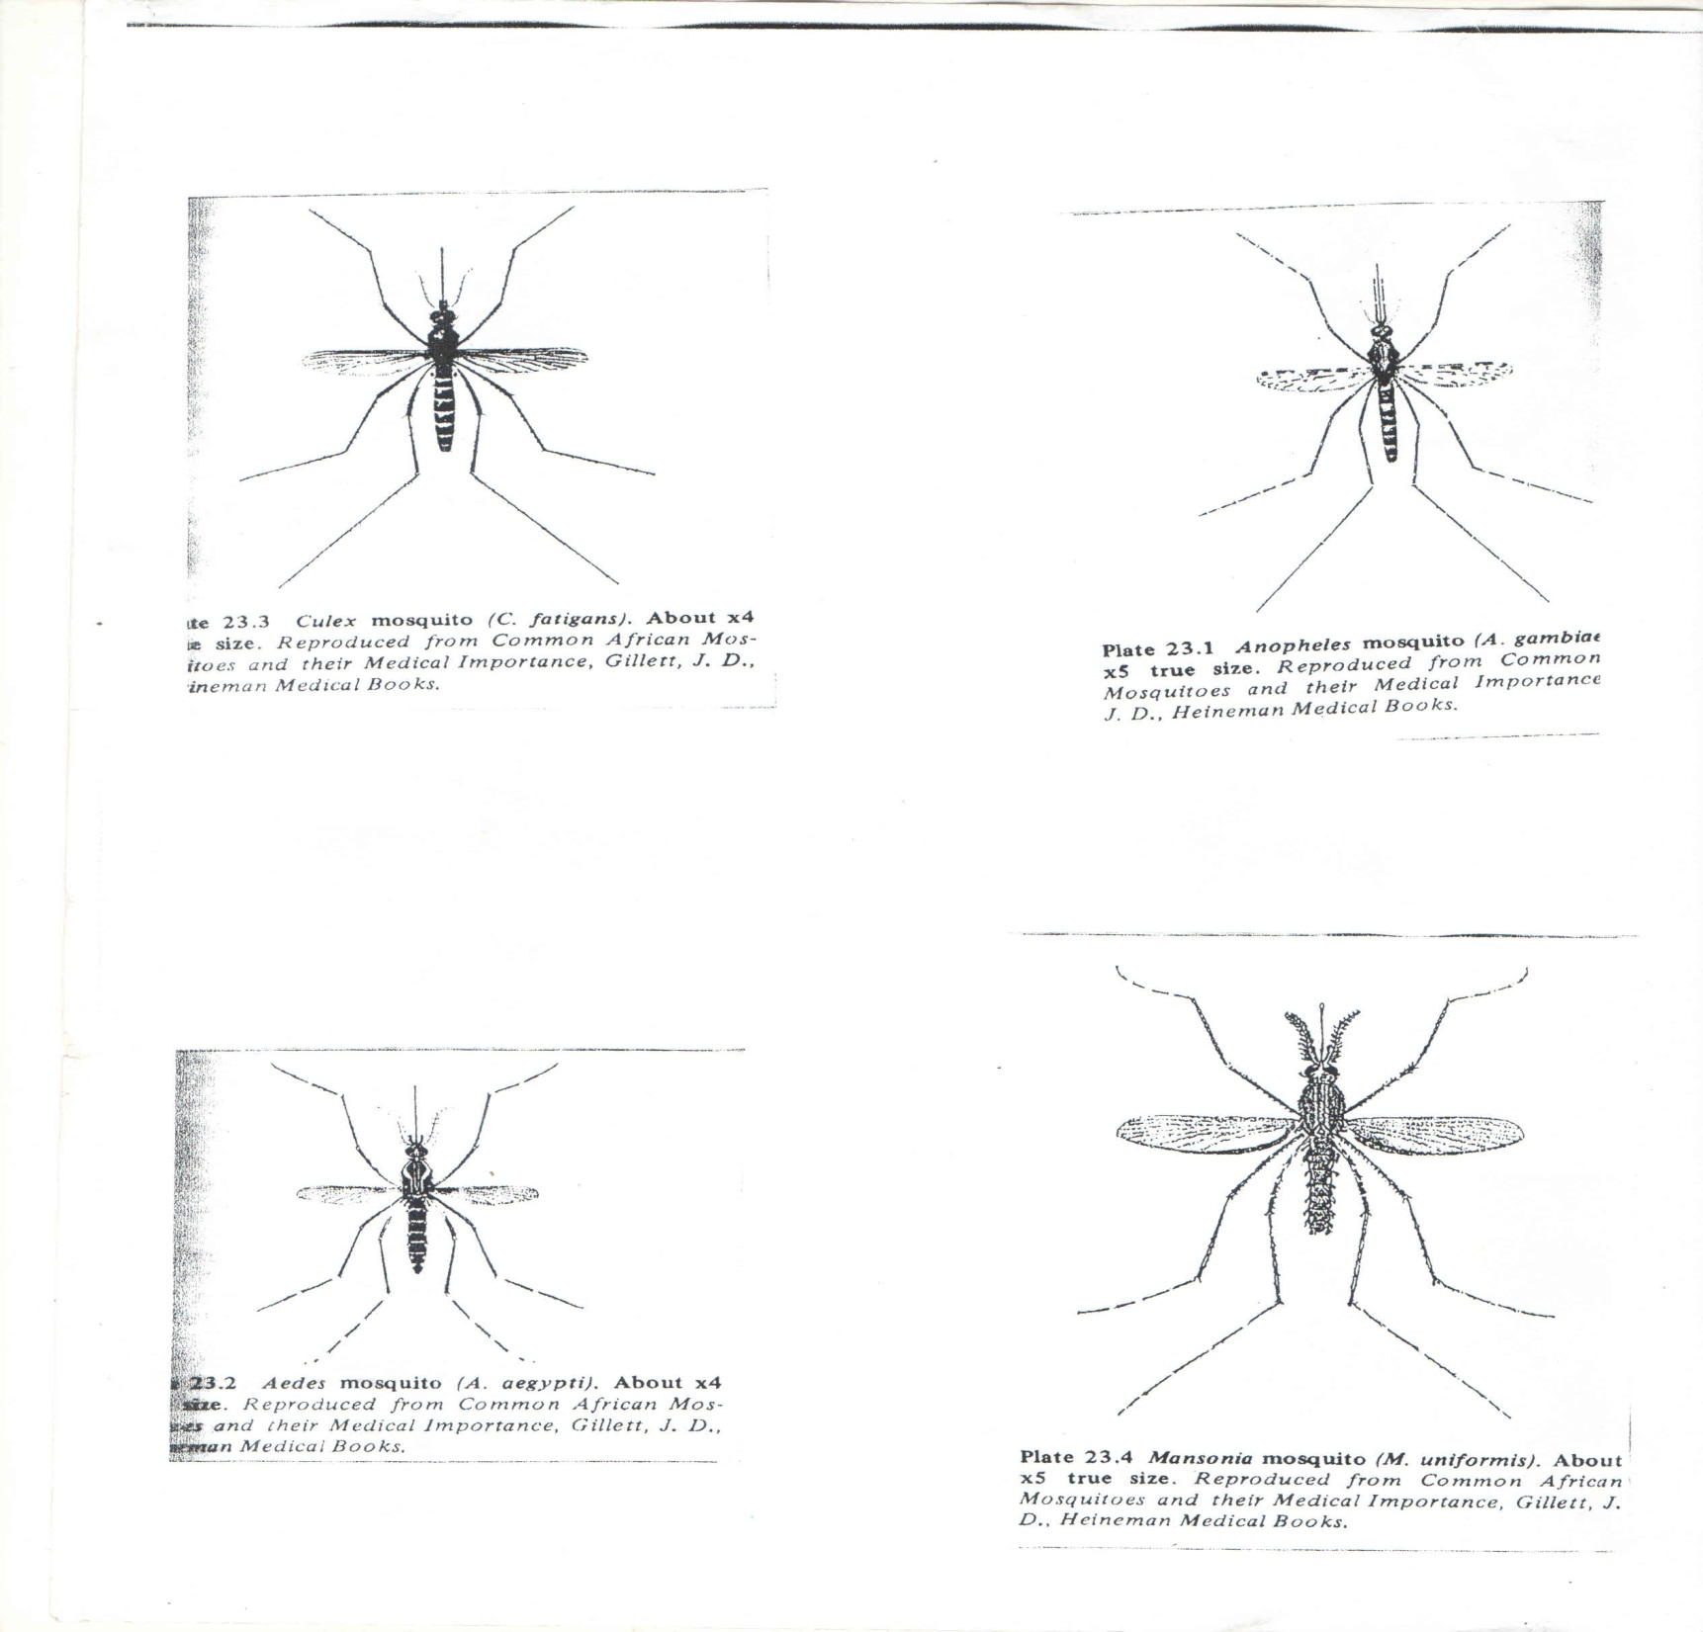

Slide 8
Family Culicidae (Mosquitoes) Cont’d
Mosquitoes of medical importance are divided into
Anopheline mosquitoes, e.g. Anopheles spp. and
Culicine mosquitoes, e.g. Aedes, Culex and Mansonia sp

Slide 9
Anopheles species
They are vectors (definitive hosts) of:
Malaria parasites
Bancroftian and Brugian filarial parasites, and
Arboviruses that cause some febrile and encephalitic diseases.
Most are twilight or night feeders although a few are also day feeders
Some feed and rest indoors; some feed outdoor and some feed indoors and rest outdoors

Slide 10
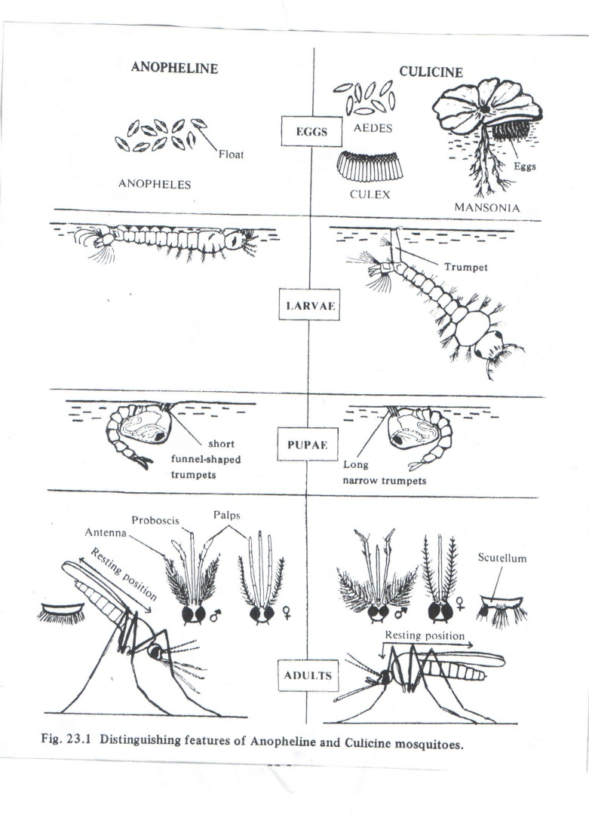

Slide 11
Anopheles species cont’d
The breeding sites are very varied and include permanent or temporary pools, swamps, seepages, rice fields, tree-holes, ditches and reservoirs.
Some species require sunlight and some species require shade for their breeding.

Slide 12
Culicine species
1. Aedes mosquitoes are vectors of
Bancroftian filariasis
Jungle and urban yellow fever
Dengue, including dengue haemorrhagic fever
Arboviruses of many febrile and encephalitic diseases such as yellow fever, Rift Valley Fever, Chikungunya, and Sindbis

Slide 13
Culicine species cont’d
The adults are ornate with patterned legs, thorax, and abdomen; the wings are not spotted
They feed during the day or night, indoors and outdoors
Their breeding sites include stagnant water in dark tree holes, coconut shells, old tins, bamboos, pots, axils of leaves of bananas/plantain trees, mud holes made by land crabs.
The forest starins breed high up in trees, in holes, or in bamboos.

Slide 14
Culicine species cont’d
Culex species are vectors of
Bancroftian filariasis
Arboviruses of several febrile and encephalitic diseases
The adults are not ornate
Many are attracted to animals
They are mostly indoor, night feeders

Slide 15
Culicine species cont’d
2. Culex species are vectors of
Bancroftian filariasis
Arboviruses of several febrile and encephalitic diseases
The adults are not ornate
Many are attracted to animals
They are mostly indoor, night feeders

Slide 16
Culicine species cont’d
3. Mansonia species are vectors of
Brugian filariasis and Bancroftian filariasis.
Adults are of moderate size and strongly built
They feed at night, indoors and outdoors, and during the day in swamp forests
They breed in swamps, paddy fields, ponds or collections of water in water plants or swamp grass

Slide 17
Culicine species cont’d
The siphon of the larva is short, conically-shaped and modified for piercing submerged stems and roots of plants to obtain oxygen.

Slide 18
Family Psychodidae
Two Subfamilies are of medical importance: Psychodinae which contain moth flies and are of slight parasitological importance they breed in substrates rich in decomposing organic matter;
some are found in cesspools and drains; some are involved in the mechanical transmission of nematodes that parasitize livestock, and Phlebotominae which consist of sand flies and are of great medical importance.

Slide 19
Sandflies (Phlebotomine flies)
These are vectors of
Visceral leishmaniasis
Cutaneous leishmaniasis
Mucocutaneous leishmaniasis
Sandfly fever
Oroya fever (also known as Carrion’s disease)

Slide 20
Sandflies (Phlebotomine flies) cont’d
They are small, hairy, yellow or grey-coloured insects
They are found in warm and hot climates, in dry desert-like regions or in humid forest areas
They fly near to the ground in short hop-like flights near their breeding sites
The female sucks blood from humans, rodents, dogs and other animals; the males feed on plant juices
The eggs are laid in cracks and holes in moist ground, including animal burrows and under stones and bricks

Slide 21
Sandflies (Phlebotomine flies) cont’d
There are four larval stages; larvae feed on organic matter
From egg laying to adult emergence takes 35-60 days, depending on temperature and availability of food
Adult life-span is a few weeks, and it rests on tree trunks, in tree holes, on walls and in cracks and crevices.
Adult Sandflies feed at night or at twilight and early morning; although some feed during the day

Slide 22
Sandflies (Phlebotomine flies) cont’d
They are weak flyers, navigating only short distances and are inactive when the wind is blowing;
they avoid hot, dry places, however, there are desert species that thrive by hiding in dry mud cracks and burrows, emerging only during humid (night) hours which coincide with the times of human activities

Slide 23
Sandflies (Phlebotomine flies) cont’d
There are two generally recognized Old World genera of sandflies, Phlebotomus and Sergentomyia and one American, the genus Lutzomyia
Phlebotomines require a combination of darkness, high humidity, organic debris on which larvae feed, and possibly a sleeping host.

Slide 24
Family Simuliidae
Simulid flies are commonly known as black flies although many species are gray or tan
Their wings are broad and iridescent, with strongly developed anterior veins
They are small, 1.0mm-5.0mm long, the prescutum of their mesonotum is reduced, giving them a humpbacked appearance, which explains their other common name, buffalo gnat
Black flies are found worldwide but are most abundant in northern temperate and subarctic zones

Slide 25
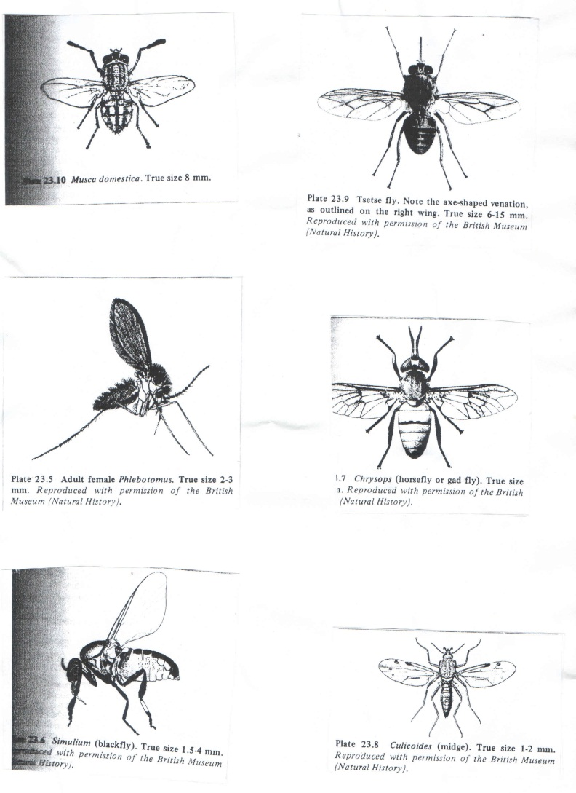

Slide 26
Family Simuliidae cont’d
Larval development occurs only in running well-oxygenated water;
they are, therefore, most numerous near rivers and streams, although they are able to travel several miles when aided by winds
Individuals react differently to black fly bites: few people have little or no reaction;
most develop local reactions in the form of reddened, itching wheals

Slide 27
Family Simuliidae cont’d
Black fly fever, a combination of nausea, headache, fever and swollen limbs, occur in particularly sensitive persons.
Black flies are vectors of Onchocerca volvulus, the cause of human onchocerciasis.
The most common vector in Africa is S. damnosum, and also S. neavei

Slide 28
Family Simuliidae cont’d
In the new world, S. ochraceum, S. metallicum, S. callidum and S. exiguum are the most efficient vectors because of their preference for humans and the timing of their activity coinciding with that of humans
Onchocerca. gutterosa commonly is transmitted to cattle by S. ornatum in Europe, whilst in Australia Simulium and Culicoides spp infect cattle with Onchocerca. gibsoni, causing considerable loss to flesh and hides.

Slide 29
Family Simuliidae cont’d
Sand fly bites are painful and often cause allergic reactions.
The female feed on the blood of humans and animals, tearing the skin until a blood vessel is damaged.
Both male and female also feed on plant juices.
The eggs are laid on rocks just below the surface of flowing water or on vegetation dipping into the water.

Slide 30
Family Simuliidae cont’d
The larvae and pupae remain attached to rocks and dead leaves, feeding on small organic particles filtered from the water;
there are 6-9 larval instars.
Breeding peak is during the rainy season

Slide 31
Family Ceratopogonidae
The family comprises the biting midges, also called ‘punkies’ ‘no-see-ums’ and sand flies
They are very small, usually less than 1.0mm long, but ferocious insects, able to crawl through window screening.
Most are daytime feeders; unable to cope with blowing winds

Slide 32
Family Ceratopogonidae cont’d
Most of the 60 or more genera feed on insects; members of only four genera feed on mammals, including humans:
Culicoides, Forcipomyia, Austroconops and Leptoconops
Only females feed on blood, for which the mouth parts are adapted
The adults have narrow wings, with few veins, often distinctly spotted, and are folded over the abdomen when at rest.

Slide 33
Family Ceratopogonidae cont’d
They breed in a wide variety of situations
Larvae are aquatic or subaquatic or develop in moist soil, tree holes, decaying vegetation, and cattle dung
Some species breed readily in salt or brackish water, mostly mangrove swamps and salt marshes
Life cycle is completed between 6 months and 3 years

Slide 34
Family Ceratopogonidae cont’d
Blood-dwelling protozoan parasites are also transmitted by Culicoides spp as are encephalitis viruses, bovine ephemeral fever and African horse sickness.

Slide 35
Family Tabanidae
Tabanid flies belong to the Sub Order Brachycera, a group of mostly robust flies, with antennae reduced to three apparent segments, the terminal one being drawn into a sharp point, or style; wing venation is reduced
They are commonly known as horseflies and deer flies, and of world wide distribution.

Slide 36
Family Tabanidae cont’d
They are large, powerful flies, quest fiercely for blood (only the females feed on blood;
males live on plant juices-they lack mandibles), and are mainly daytime feeders
There are about 4000 species in 30-80 genera
Tabanid flies have similar mouthparts to those of Ceratopogonidae and Simulidae but are stouter and stronger

Slide 37
Family Tabanidae cont’d
In biting, the mandibles cut in a scissors-like motion, whilst maxillae pierce and rend tissues, rupturing blood vessels;
the fly feeds on a pool of blood that wells into the wound (telmophagy)
Tabanids usually breed in aquatic or near aquatic environments, although some complete larval development in soil.

Slide 38
Family Tabanidae cont’d
Females generally lay between a hundred and a thousand eggs, at the edge of water or on overhanging vegetation or rocks
At egg-laying time, such locations may be swarming with ovipositing flies.
On hatching, larvae fall or crawl into water or burrow into mud

Slide 39
Family Tabanidae cont’d
Many feed on organic debris, but others are voracious predators on insect larvae, worms and other soft-bodied animals, including other horse fly larvae and even toads
Several species of horse flies are serious pests of humans and livestock
The name deer fly is applied to the genus Chrysops;
they are smaller that horse flies and have brown-spotted wings

Slide 41
Family Tabanidae cont’d
Their flight is less noisy hence they bite humans more commonly
Tabanids are of medical importance in the following ways:
Their annoyance of humans
Blood loss caused by their bites, and
The infections transmitted mechanically and biologically

Slide 42
Family Tabanidae cont’d
Characteristics that enhance the capability of Tabanids to transmit pathogens include:
Anautogeny- the necessity of blood meal for egg development, which stimulates host-seeking behavior.
Telmophagy-through which blood-dwelling pathogens can enter the pools of blood from which the flies suck
Relatively large blood meals-enhancing the possibility that pathogens will be imbibed

Slide 43
Family Tabanidae cont’d
vi. Long engorgement time-enabling pathogens to infect a fly’s tissues, and
v. Intermittent feeding behavior-increasing the chances for mechanical transmission of pathogens

Slide 44
Family Tabanidae cont’d
Tabanids transmit protozoan, helminthic, bacterial and viral diseases of animals and humans-
Among protozoan diseases, two species of Trypanosoma are transmitted mechanically by Tabanids;
these are: T. evansi which causes ‘surra’ in many wild and domestic animals and is spread by species of Tabanus although other vectors may be stable flies, other genera of horse flies and vampire bats;
and T. theileri, a cosmopolitan parasite of cattle and antelopes

Slide 45
Family Tabanidae cont’d
Cyclopropagative development takes place in the gut of the insect, thus making the species involved actual intermediate hosts
The eye worm, Loa loa is also transmitted by species of Chrysops.

Slide 46
Family Glossinidae
This family contains a single genus, Glossina, and occurs only in Africa and two localities on the Aratian peninsula
Glossina species (Tsetse flies)
They are about 7.5mm – 14.0mm long and brownish gray; at rest, their wings cross over each other like a pair of scissors
The base of the proboscis is swollen into a characteristic bulb
The flies are daytime feeders and are visually attracted to moving objects

Slide 47
Family Glossinidae cont’d
Both sexes feed exclusively on blood of a wide variety of animals, including humans but are particularly attracted to pigs
The mouthparts and thus, feeding habits are much like those of stable flies
The flies are larviparous and pupiparous, giving birth to a single, completely developed larva at intervals, producing from 8-20 in all.

Slide 48
Family Glossinidae cont’d
While in the oviduct, larva feeds on secretions from specialized milk glands;
larvae are deposited on loose, dry soil, usually, under the shelter of some type
Being without locomotor structures, the larvae, by contraction and extention, burrow into a few centimeters of loose soil

Slide 49
Family Glossinidae cont’d
The integument hardens to form a puparium within an hour of larviposition, and darkens to brownish black; pupae are barrel-shaped and have two prominent posterior lobes
Adults emerge within 2-4 weeks
Tsetse flies have chemoreceptors on their tarsi, among them sensillae that stimulate feeding when exposed to uric acid, leucine, valine and lactic acid (stimulatory ingredients in human swea)t

Slide 50
Family Glossinidae cont’d
Female G. morsitans also respond to chemicals released by larvae before pupation by depositing larvae in moist sand where there are already larvae-the result being aggregation in shady, relatively moist areas, especially during dry seasons

Slide 51
Family Glossinidae cont’d
Twenty-three species of Glossina are recognized, all but three of which are capable of transmiting trypanosomes of mammals;
six of these are of medical importance: G. palpalis, G. fuscipes and G. tachnoides are found along rivers as primary vectors of Gambian sleeping sickness;
G. morsitans, G. swynnertoni and G. pallidipes are savanna species and principal vectors of Rhodesian sleeping sickness

Slide 52
Family Glossinidae cont’d
It is probable that all of these, as well as other several species, are able to transmit ‘nagana’ to cattle
The flies, generally, are more numerous during the rainy season.
The life-span is 2-3 months.

Slide 53
Family Muscidae
Members are synanthropic (i.e. they live closely with humans and share homes, food and drinks with humans, where possible)
They are medium-sized, usually dull-coloured.
Musca domestica is a typical member of the family and commonly known as the House fly
It is cosmopolitan in distribution

Slide 54
Family Glossinidae cont’d
They breed in all kinds of organic wastes, except decaying flesh;
faeces of any kind are preferred, although decaying milk around dairy barns, slops, around hog troughs, silages, rotten fruit and vegetables, are also attractive to them

Slide 55
Family Glossinidae cont’d
Garbage cans are a favourable breeding place, and rotting garbage in the tropics can become transformed into an apparently equal mass of maggots, overnight
Under favourable conditions, eggs develop into adults in 10 days
A female deposits 120-150 eggs in each of at least 6 lots in its life-time
House flies are efficient disease carriers for three main reasons

Slide 56
Family Glossinidae cont’d
Their structure favours carrying bacteria-the multitude of tiny hairs covering most of the body readily collects bacteria, spores, cysts and helminth eggs, and their mouthparts and feet also have sticky pads that collect such material.
They relish human food and excrement alike; while feeding they also defecate and vomit the remains of their last meal.
Helminth eggs, protozoan cysts and bacteria survive the intestinal tract of flies

Slide 57
Family Glossinidae cont’d
iii. Due to their synanthropic and powerful flight, house flies move about freely, hence are ideal vehicles for mechanical transmission of disease pathogens

Slide 58
Family Glossinidae cont’d
Diseases, or their agents, transmitted by houseflies are too numerous to be listed but they include:
Most enteric diseases from faecal contamination, such as typhoid fever, cholera, polio, hepatitis, shigellosis, salmonellosis and other dysenteries
Yaws, leprosy, anthrax, trachoma, tuberculosis
Worm infections such as Ascaris sp
Several diseases of domestic animals are also transmitted

Slide 59
Stomoxys calcitrans (the Stable fly)
This species is the only member of the genus Stomoxys; it is cosmopolitan
Molecular evidence points to a high level of gene flow among S. calcitrans populations, suggesting equally high intercontinental mobility, though the species occurs mostly in N. America
In appearance it is similar to M. domestica
Stable flies are daytime feeders; both sexes feed on blood.

Slide 60
Stomoxys calcitrans (the Stable fly)
The labella of the mouthparts are equipped with rows of teeth that can readily pierce skin and underlying tissues
The flies then sponge up blood that wells into the wound
The flies avidly bite humans and other animals, especially cattle, horses, and prefer to breed in decaying vegetation rather than manure, though they are adaptable

Slide 61
Stomoxys calcitrans (the Stable fly)
Their attack, in large numbers on humans, is intolerable;
the species is an important pest of livestock, causing weight loss, reduced milk production and damage to hides,
and adult cattle death, if bitten several times

Slide 62
Stomoxys calcitrans (the Stable fly)
Diseases transmitted by stable flies are: surra, caused by Trypanosoma evansi;
mechanical transmission of T. brucei complex; epidemic relapsing fever, antrax, brucellosis, swine erysipelas, equine swine fever, African horse sickness and fowl pok
Stable flies are intermediate hosts of the horse stomach worm, Habronema microstoma, which infects horses when infected flies are swallowed

Slide 63
Stomoxys calcitrans (the Stable fly)
Control
Besides insecticides, there is also the release of parasitoid wasps,
e.g. Muscidifurax raptor and solar-powered traps designed to attract both house and stableflies

Slide 64
Haematobia species (Horn flies)
Haematobia species (Horn flies) are also known as Hydrotaea irritans, occur in the Americas, Europe, Asia Minor and Africa.
They closely resemble stable flies but are more slender
They may bite humans but are not active fliers as stable flies; they are more of veterinary importance.

Slide 65
Myiasis
Myiasis is generally, an infection/disease caused by fly maggots of various species of fly families. There are several categories of myiasis as in parasitism, as follows:
Obligatory myiasis-the insect depends on a period of parasitism before completing its life cycle
Facultative myiasis- a normally free-living maggot becomes parasitic when it accidentally gains entrance into a host

Slide 66
Myiasis cont’d
Other terms are useful in describing the location of larvae:
gastric, intestinal, or rectal for invasion of the digestive system; nasopharyngeal, for nose, sinuses, and pharynx;
cutaneous, either creeping, when larvae burrow through the skin, or furununcular, if they remain in a boil-like lesion; urinary or urogenital; auricular for the ears, and ophthalmic for the eyes.

Slide 67
Myiasis cont’d
Some larvae are intermittent blood suckers and are loosely included under the term myiasis.
Accidental myiasis is usually enteric, occurring when eggs or larvae are eaten with contaminated food or usually involves muscoid flies, such as M. domestica and
The families of flies that cause Myiasis include:

Slide 68
Family Calliphoridae
The large family of blow flies, most of which help to destroy carcasses; a few cause myiasis
They are usually of metallic green, blue, or copper colour, though some are non-metallic
Common species include:
Calliphora vomitaria- can cause pseudomyiasis
Phaenicia spp e.g. P. sericata
Lucilia spp e.g. L. cuprina. These cause wool strike of sheep in Australia

Slide 69
Family Calliphoridae cont’d
Some species of calliphorid blow flies limit infections in wounds.
Others, such as some species of Phormia, Cochliomyia and Chrysomya are facultative parasites

Slide 70
Family Calliphoridae cont’d
Cochliomyia hominivora- this is the New World Screw worm, one of the most important causes of myiasis;
it is an obligate parasite, occurring throughout the Neotropical region
It causes dermal myiasis in nearly any mammal as well as nasopharyngeal myiasis in humans

Slide 71
Family Calliphoridae cont’d
Adult flies are a deep, greenish-blue metallic colour with a yellow-orange, or reddish face and three dark stripes on the thorax;
it is difficult to differentiate C. hominivorax from C. macellaria, the secondary soreworm, which is not an important cause of myiasis

Slide 72
Family Calliphoridae cont’d
Screwworm larvae cannot penetrate intact skin, although mucous membranes of the face and genitalia are susceptible to their attack.
Usually a pre-existing wound, however small, attracts the fly
Generally, the more abundant the worms are in livestock, the greater the chances of human infection

Slide 73
Family Calliphoridae cont’d
Infection in the head can be fatal whilst urogenital infection can be grossly deforming.
The best control of this pest so far developed is the use of the sterile male technique- laboratory reared and sterilized males are released to mate with wild females.
Since females of this species usually mate once, they, thus, cannot produce offspring after a sterile mating.
C. hominivorax has been eliminated from the US and is present only in the Mexican State of Yucatan.

Slide 74
Family Calliphoridae cont’d
The Old World Screwworm, Chrysomya bezziana occurs in Africa, India, the Philippines, Australia, and the East Indies.
Its biology, veterinary importance and control strategies are almost identical to those of Co. hominivorax.
Two races are believed to exist, from molecular studies: one from sub-Saharan Africa and the other from Asia.

Slide 75
Family Calliphoridae cont’d
Estimates are that for sterile male control technique, it would require 250 million sterile males a week and 5 years to eliminate this pest epidemic in Queensland, Australia.
There are other related species occurring in these same regions
They are metallic green or blue-green in colour

Slide 76
Family Calliphoridae cont’d
They burrow deep into tissues, hence producing ulcers around the eyes, ears, nose and mouth

Slide 77
Family Calliphoridae cont’d
Cordylobia anthropophagi (The tumbu fly)
This is a calliphorid restricted to Africa, south of the Sahara; the adults are yellowish
They are stimulated to lay eggs in soil that has been contaminated with urine
Many wild mammals are reservoirs
They cause cutaneous myiasis

Slide 78
Family Calliphoridae cont’d
Auchmeromyia luteola (The Congo Floor Maggot)
This is a blood-sucking species found south of the Sahara
It is the only dipteral larva known to suck human blood
Eggs are laid on floor mats, dry soil or crevices in huts; larvae are quite resistant to dessication
They feed like bed bugs, feeding takes 15-20 mins
Blood-sucking maggots of birds are known

Slide 79
Family Sarcophagidae (Flesh flies)
These are ubiquitous and closely related to the Calliphoridae except that they are not metallic but have abdomen checkered gray and black
They often parasitize insects, snails and other invertebrates
Most are larviparous and normally breed in carrion, but females deposit larvae in open wounds

Slide 80
Family Sarcophagidae (Flesh flies) cont’d
The species Sarcophaga hemorrhoidalis is widespread in the northern hemisphere but also found in the tropics;
it looks like a large house fly except that the tip of the male abdomen is red.
Wohlfartia magnifica is another species that is a facultative parasite of mammals in warmer areas of the Palearctic region.
Fatal human cases have been reported.

Slide 81
Family Sarcophagidae (Flesh flies) cont’d
W. vigil causes cutaneous furuncular myiasis in Canada and the northern U.S
Larvae are deposited on urbroken skin, and they quickly penetrate it.
Human infections usually occurs in infants left unattended to, outdoors, but sleeping adults have been infected indoors
Rodents, rabbits and carnivores are reservoir hosts.

Slide 82
Family Oestridae (Bot flies)
Dermatobia species is the human skin bot fly; it ranges from Mexico through most of S. America, being a forest-inhabiting fly
It develops in the skin of almost any warm blooded animal, including birds,
Unlike any other myiasis- causing fly, D. hominis does not lay its eggs directly on a host.
Instead, it catches another insect, such as a mosquito and glues its eggs on the side of it, with the operculated anterior end hanging down.

Slide 83
Family Oestridae (Bot flies) cont’d
At least 18 species of flies and one specie of tick are carriers, it is reported
When a carrier insect lands on warm skin, the eggs hatch immediately, and larvae drop onto the new host, penetrating its unbroken skin
and boring into the dermis and for several weeks develops; pupation is in the soil.

Slide 84
Family Oestridae (Bot flies) cont’d
The fly commonly parasitizes humans, causing painful lesions, allergic reactions and painful swellings.

Slide 85
Family Fannidae
This contains over 260 species, majority being of the genus Fannia.
The species F. canicularis is the lesser house fly, and resembles Musca domestica, except it is smaller and more slender,
and dark; it has only three brown longitudinal stripes on the thorax, instead of four as in M. domestica.
Its biology parallels that of the common house fly

Slide 86
Family Fannidae cont’d
It may enter houses freely, but is not particularly attracted to food as is M. domestica, hence not a serious vector of pathogens of humans or other animals
The species, F. scalaris is the Latrine fly; it breeds in fresh dung, particularly that of swines; it seldom enters houses.
Both species cause accidental myiasis of the rectum of humans;
it is presumed they lay eggs on the anus and larvae crawl into the rectum and develop there.

